Slide 1
Security Analysis of Classmate System
Phase#2
CMU X LGE Security Specialist Course
TEAM5 (DEFENSE)

Slide 2
PURPOSE
Phase #1: We conducted threat modeling and mitigation to develop a safe program by analyzing and evaluating the threats related to the security of the ALPR program
Phase #2 In order to discover and analyze the vulnerabilities of the class mate program, find out how to use various security tools, check the effectiveness, and prove as exploit

Slide 3



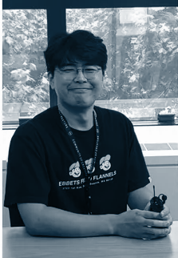
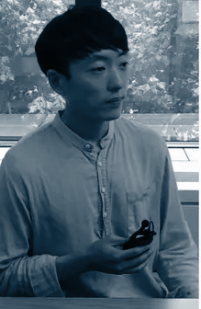

Our Team
Jinhwan
Kim
Paul Lim
Jongsoo Oh
Sangwook
Lee
Minyong Ha
Dawoon
Park
Threat Modeling
Risk Assessment
Validation
Client App
Development
Client Security
Architecture
System/Security Requirement
2FA (OTP)
DB, Mail management
Server Security
JWT
Cryptography
Server Development
Server Security
TLS, Certificate
Surface Analysis
Code Review
Static Analysis
Reverse Engineering
Design Analysis
Overall Architecture
Static Analysis
Runtime Analysis
Authentication
/Cryptography Analysis
Reverse Engineering
Code Review
Notes:
test

Slide 4
Schedule for Phase #2
Mon
Tue
Wed
Thu
Fri
Week 1
Analyze Customer requirement
Define System requirement
Week 2
Define Secure Requirement & Mitigation
Threat modeling & Risk assessment
Implement Client / Server
Week 3
Make test case
Implement & integration Client / Server
Presentation 1
Week 4
Overall Design Review
Surface/Static/Runtime Analysis
Week 5
Surface/Static/Runtime Analysis
Proven vulnerability & POC
Presentation 2

Slide 5
Table of Contents
01
02
03
04
Summarization of Phase #1
Analysis
Remind activity for secure development
Secure analysis of classmate System
Vulnerability
Lessons Learned
The list of found flaws through analysis
Summarize & reflection

Slide 6
01
Summarization of Phase #1
Look back on the past activity on Phase #1

Slide 7
Security Goals
Client and server should be TRUSTED each other
TRUSTY
Data exchanged between the server and the client should be PROTECTED
PROTECTION
User credential and privacy information should be stored and managed SAFELY
SAFETY

Slide 8
Recap Activity
System Requirement
Security Goal
Threat Modeling
Analyzed and refined
Consider the asset
DFD, STRIDE, PnG
Activities
Risk Assessment
Security Requirement
Mitigation
OWASP, CVSS
Consider Impact
SQUARE &
Prioritization
Satisfy the security requirement

Slide 9
We Conducted…
TH_ID | Threat Description | Category
TH_01 | If server may be spoofed, client send the ID/PW to fake server and then attacker could steal the user ID/PW | Spoofing
TH_04 | Attacker could steal privacy data between server and client communication | Information Disclosure
TH_07 | Attacker steals the user credential/DB data in server through unauthorized access remotely | Information Disclosure
TH_11 | Attacker could be received vehicle info from server in case that fake client send the plate number to server | Information Disclosure
SR_ID | Security Requirement | Related TH_ID
SR_01 | Client and server must be authenticated to communication | TH_01,TH_09,TH_12
SR_02 | The channel between client and server must be encrypted | TH_04,TH_07,TH_11,TH_16,TH_17
SR_04 | Password must be encrypted | TH_07
SR_08 | Saved retrieved information in client must be encrypted | TH_07,TH_11
SR_10 | Private key must not be exposed | TH_01,TH_09,TH_12
SR_11 | User credentials in server must be encrypted | TH_07
SR_13 | Server must check the input validation (code injection) | TH_07

Slide 10
We Focused On…
MI_ID | Mitigation | Related SR_ID
MI_01 | client and server could be authenticated communicate → mutual authentication | SR_01
MI_02 | Server give the access authority to Client → JWT | SR_02
MI_03 | Channel encryption between client and server → apply TLS 1.2 or higher | SR_02,SR_03,SR_07
MI_04 | Password encryption → Bcrypt or SHA-256 or more | SR_04
MI_06 | Input validation → Add perimeter filter(sanitizer), use JPA(JAVA Persistence API) | SR_05,SR_12,SR_13
MI_08 | Data encryption(Retrieved info, User credentials, Vehicle info) → AES256 or more | SR_08,SR_11
Apply to Authentication
TLS/SSL, 2FA, Token(JWT)
Data Encrypt
SHA-256, AES
Sanitize
Input validation

Slide 11



TEAM5 Project Architecture
Trust boundary
Trust boundary
Client
License plate server
(Spring web server)
MI_04
MI_01,MI_03
UX Manager
SHA-256
Connection
Manager
Connection
Service
Login
Service
ID/PW
TLS / JWT
TLS
MI_08
Plate
Manager
Plate
Service
DB manager
MI_03
MI_02
AES-256
IPC
MI_06, MI_08
MI_04, MI_06
Retrieved information
ALPR
AES-256
SHA-256
Playback Data
Vehicle Data
User Credential
Legend
C#
MFC
JAVA

Slide 12
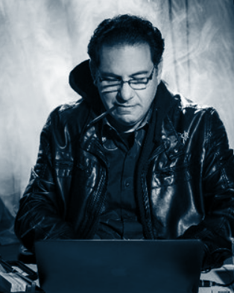
Saying…
You can never protect yourself 100%.
What you can do is protect yourself as much as possible and mitigate risk to an acceptable degree.
You can never remove all risk.
Kevin Minick

Slide 13
02
Analysis
Try to find out the vulnerability with a various methodology

Slide 14
Analysis
Design Review
D
Overall Architecture
Code/Design Review
Static Analysis
S
Coverity, Flawfinder, IDA
Runtime Analysis
R
Wireshark, nmap
My attack server is made of Console Server
So We need a HELP through Insider Threat

Slide 15
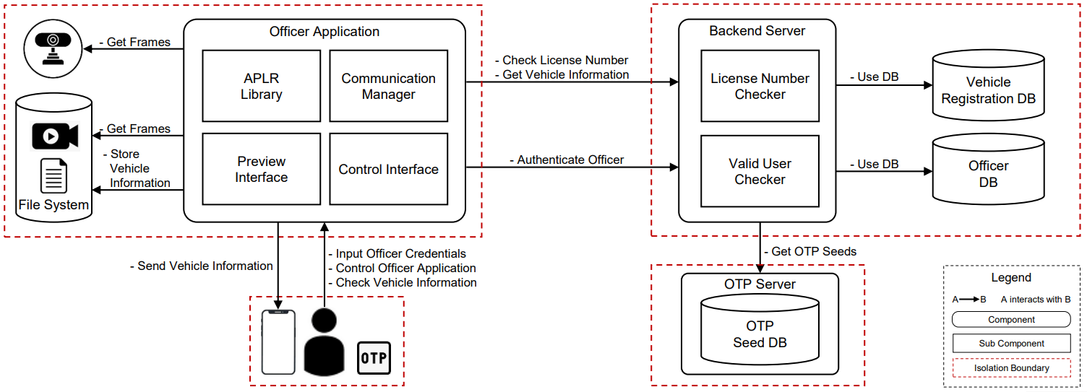
Design Review
Overall Architecture
client-conf.json
server-conf.json
DB
Network
Protocol
User auth.
2 FA
From team4’s Security Requirements,
We started looking for vulnerabilities at 6 points.

Slide 16
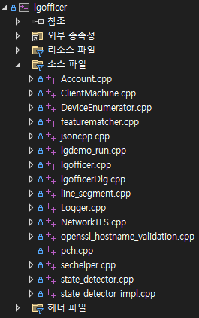
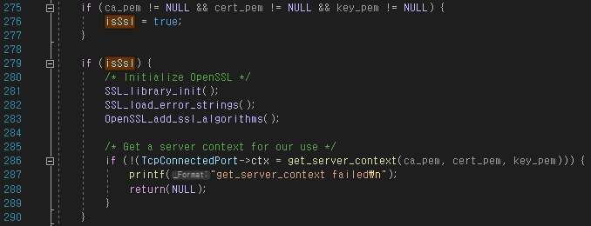
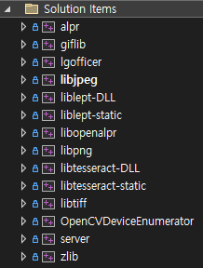
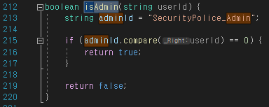
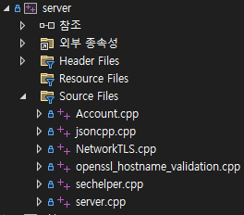

Code Review
On/Off TLS
Admin ID
Backdoor ID
DB Control

Slide 17
Static Analysis
Flawfinder
Nothing Specials
Coverity
Found Two kind of critical Issues
Divided By Zero (Server)
Data Race Condition (Client)
Stats | Total | Open | Close | False Positive
Client | 35 | 0 | 0 | 35
Server | 15 | 0 | 0 | 15
Common | 11 | 0 | 0 | 11
Stats | Total | Open | Close | False Positive
Client | 83 | 4 | 0 | 79
Server | 8 | 1 | 0 | 7
Common | 15 | 0 | 0 | 15
Commercial SW has much powerful than freeware SW
So we recommend commercial SW to get better result :)

Slide 18
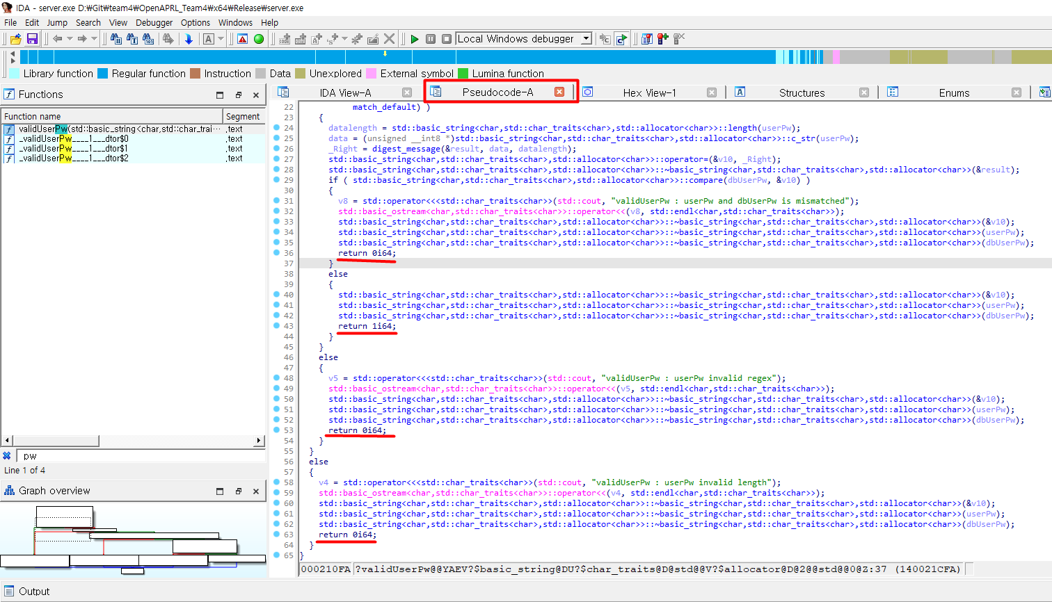
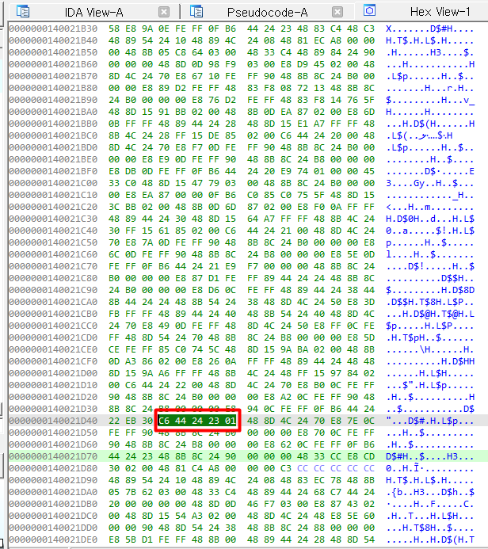
Static Analysis
IDA (Reverse Engineering Tool)
We can find code and map to memory address. Binary could be manipulated

Slide 19
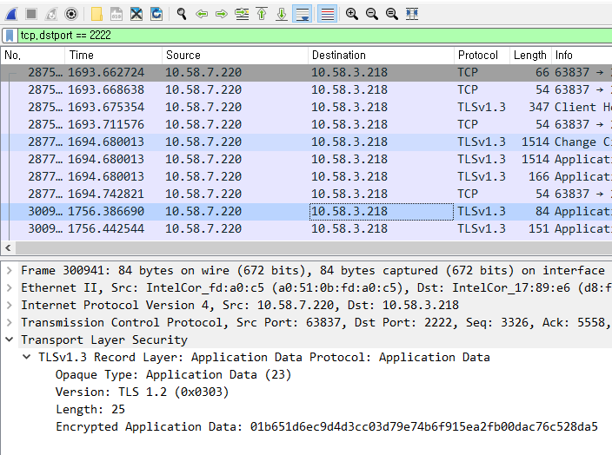
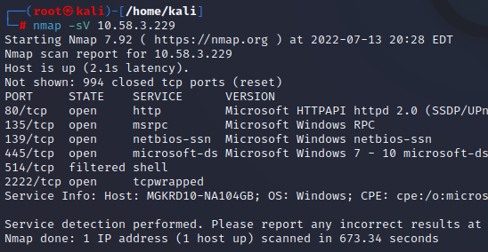
Runtime Analysis
WireShark
nmap
Data was Encrypted by TLS1.3
Protected by tcpwrapper.
TCP PACKET and SERVER Program are protected.
Plain text data cannot be checked, and metasploit cannot be used.

Slide 20
03
Vulnerability
Describe exposed Vulnerabilities

Slide 21
Criteria
Location
Approach
Location of the part that is related to the vulnerability
Know how to find vulnerability
CIA
Impact
CONFIDENTIALITY
INTEGRITY AVAILABILITY
Using CVSS v3.1 base score
- CRITICAL
- HIGH
- MEDIUM
- LOW

Slide 22
Exposed Vulnerabilities
System Context Diagram
Nothing Specials
client-conf.json
server-conf.json
DB
Network
Protocol
User auth.
2 FA
Finally, we found 13 vulnerabilities

Slide 23
Exposed Vulnerabilities
No
Vulnerability
Approach
Impact
CIA
V01
Existence of backdoor in code
Code Review
High
Confidential
V02
Infer to password of each account easily
Tinkering
Medium
Confidential
V03
Included dangerous logic when checked authentication
Code Review
Medium
Confidential
V04
Service attack by “Divided by Zero”
Static Analysis
Medium
Availability
V05
Authentication could be skipped by manipulating binary
Reverse Engineering
Medium
Integrity
V06
Tampering configuration file(server-conf.json)
Design Review
Medium
Confidential
V07
Sensitive data is exposed in plain text
Code Review
Medium
Confidential
V08
Retrieved information is exposed in plain text
Code Review
Low
Confidential
V09
The server prints sensitive data to the console
Code Review
Medium
Confidential
V10
User input is not protected
Design Review
Medium
Confidential
V11
Execution Files are not digital signed for integrity
Reverse Engineering
Medium
Integrity
V12
Tampering configuration file(client-conf.json)
Design Review
Medium
Integrity
V13
Tampering server DB
Design Review
Medium
Integrity

Slide 24
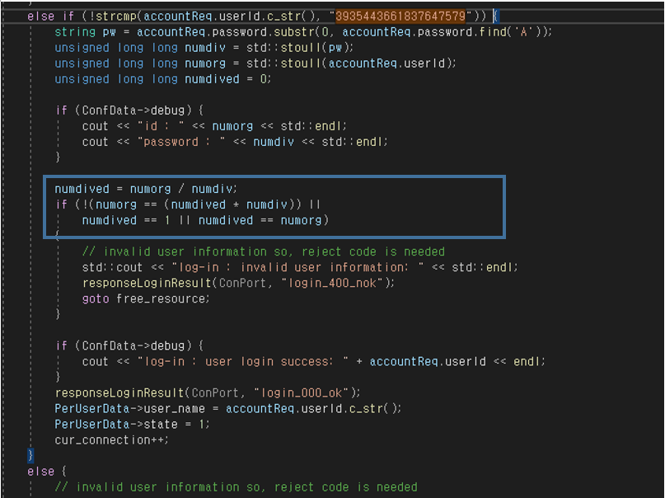
Vulnerabilities(Details)
V01 Existence BackDoor Code for Log-In
We found backdoor code for logIn
in this code.
ID : 3935443661837647579
PW : 13245233323Aa!
-> The divisible value of 3935443661837647579 (1324523323 or 2971215073 + Aa!)
OTP : xxxxxx -> any 6 numbers
Impact
- An attacker can login without account
Mitigations
- Delete backdoor

Slide 25

Vulnerabilities(Details)
V01 Existence BackDoor Code for Log-In
We found backdoor code for logIn
in this code.
ID : 3935443661837647579
PW : 13245233323Aa!
-> The divisible value of 3935443661837647579 (1324523323 or 2971215073 + Aa!)
OTP : xxxxxx -> any 6 numbers
V01 Existence BackDoor Code for Log-In
If a specific value is entered as ID/PW regardless of ID/PW, system log-in is possible without OTP knowledge through code review.
ID : 3935443661837647

Slide 26
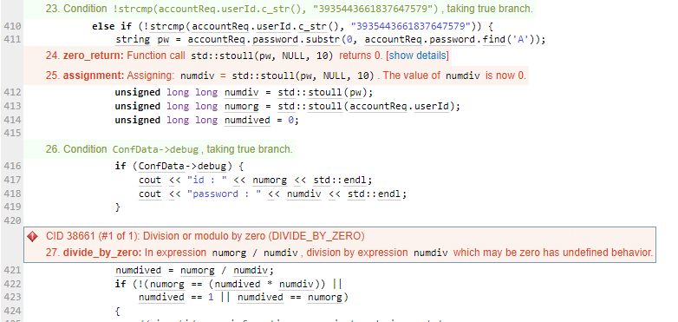
Vulnerabilities(Details)
[Result of static analysis]
V04 - Service attack by “divided by Zero”
We found existence Divided by Zero through static analysis and used this to unavailable the server.
If client send “0(zero)” as password,
Server will be terminated(Runtime error)
Impact
- Server is terminated
. Service unavailable
Mitigations
- Delete backdoor

Slide 27
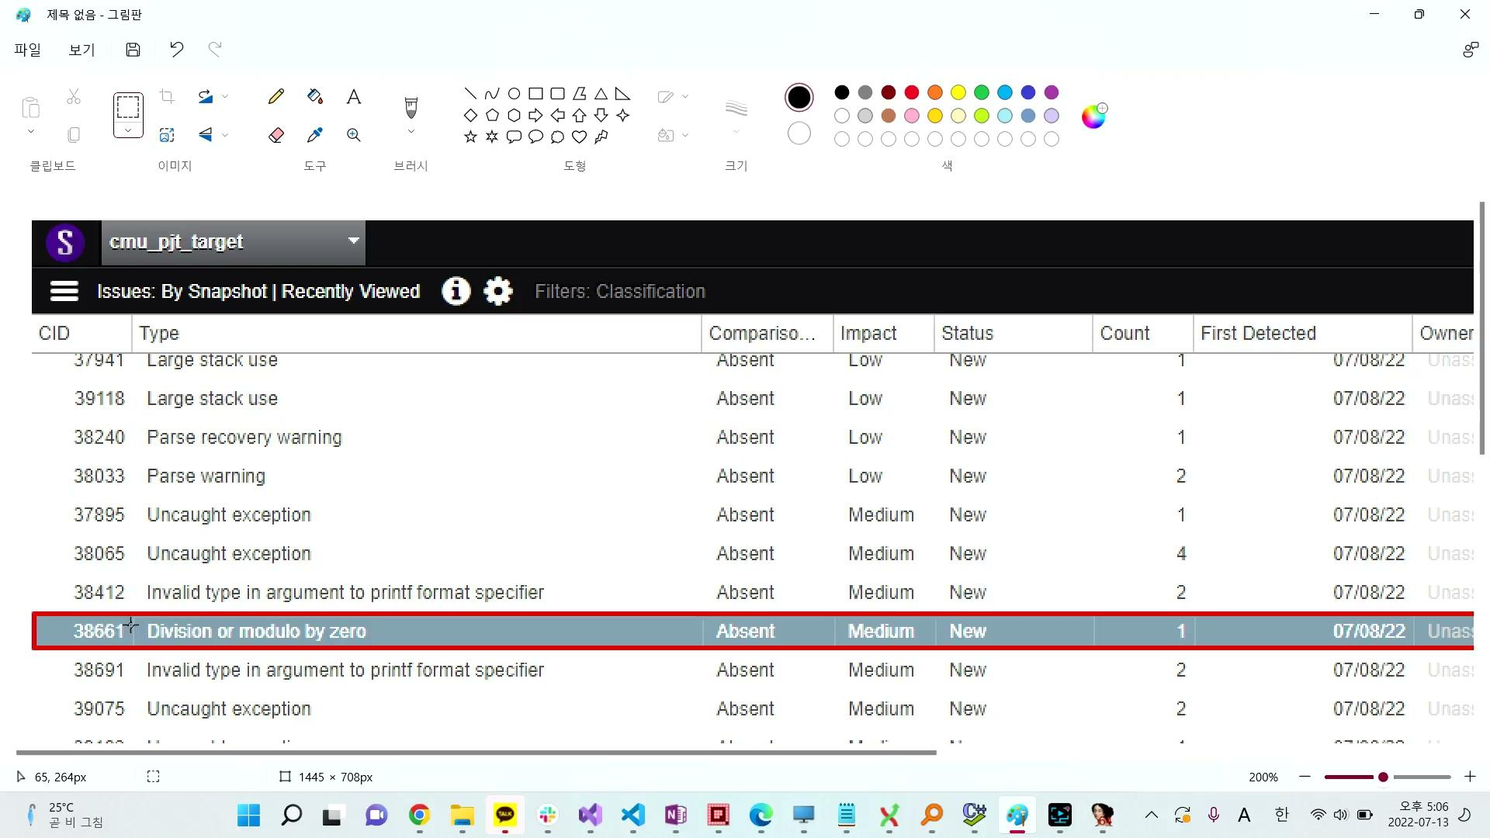
Vulnerabilities(Details)
V04 - Service attack by “divided by Zero”
Coverity Tool found Divide by Zero
When Backdoor ID log-in
- ID: 3935443661837647579
- PW: 000000Aa!
- OTP: 111111
Password is recognized as “0” and executed to “Device by zero”

Slide 28
Vulnerabilities(Details)
V05 - Authentication could be skipped by manipulating binary
There is no meaning about password and 2FA after manipulating memory with IDA tool
Impact
- No credential, No Authentication
Mitigations
- Apply to obfuscation
- Digital signing to file

Slide 29
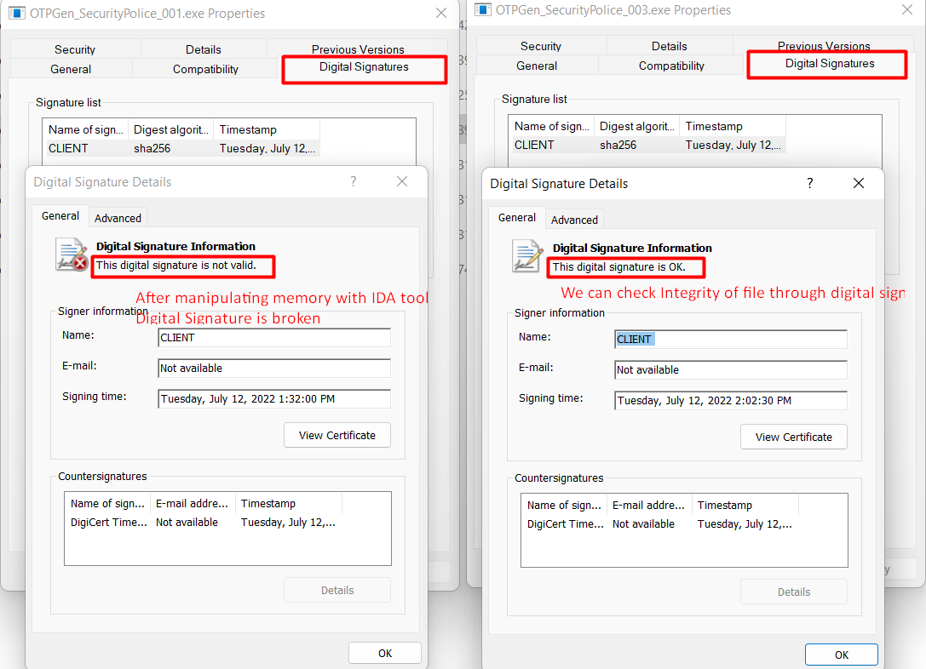
Vulnerabilities(Details)
V11 - Execution Files are not digital signed for integrity
You don’t know file modified or not
That is why Digital signing is needed to execution file
Manipulating return address
In memory

Slide 30
04
Lessons Learned
Recap the project and reflection of activity

Slide 31
Summarize & Reflection
Summarize
It is important to know and be able to use a lot of testing tools suitably when looking for vulnerabilities.
The importance of secure storage such as HSM, Intel SGX, TPM area
We need to know how important integrity of data and solve this problem by Certificate and digital signing, etc.
Reflection
As you know we don’t have a lot of time and we felt no time to all activity perfectly. so we only use basic function on each tool and couldn't utilized usefully due to different environment of platform. In the next time of chance, we will try to improve our understanding of a tools deeply and learn how to use more.

Slide 32

Q&A
Feel free to talk about presentation
If not, how about Top-Gun
Thank you for everything!

